Slide 1
Graph RAG
By Microsoft

Slide 2
Overview
Conventional RAG
Graph RAG
Questions

Slide 3
Conventional RAG Limitations
Limited Contextual Understanding
Scalability issues (Retrieval process for complex data)
Complexity

Slide 4
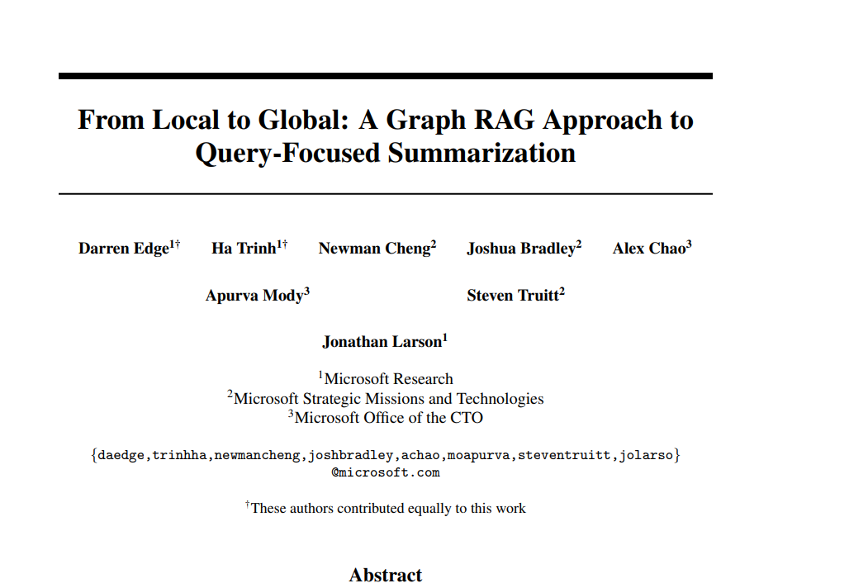
GraphRAG
Paper from Microsoft regarding graphRag approach : [2404.16130] From Local to Global: A Graph RAG Approach to Query-Focused Summarization (arxiv.org)

Slide 5
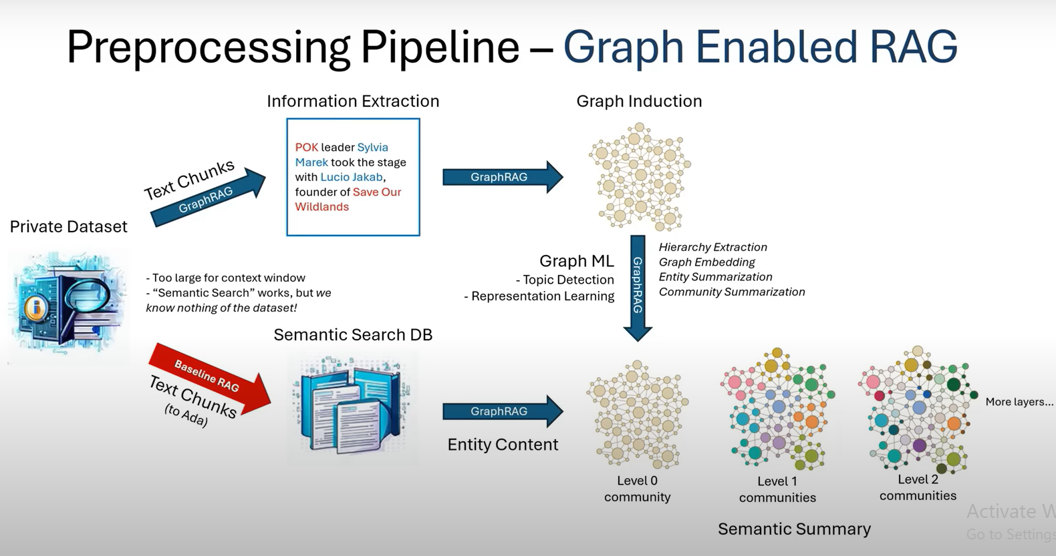
Graph RAG explanation:

Slide 6
Questions:
How does code build edges between nodes in knowledge graphs?
How does code transverse knowledge graph to retrieve evidences?

Slide 7
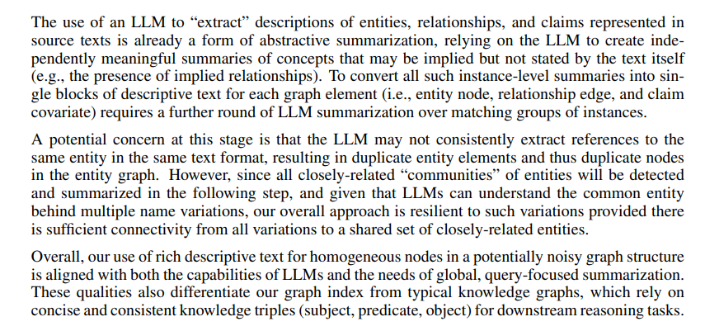
Knowledge graphs- Reference from paper:

Slide 8
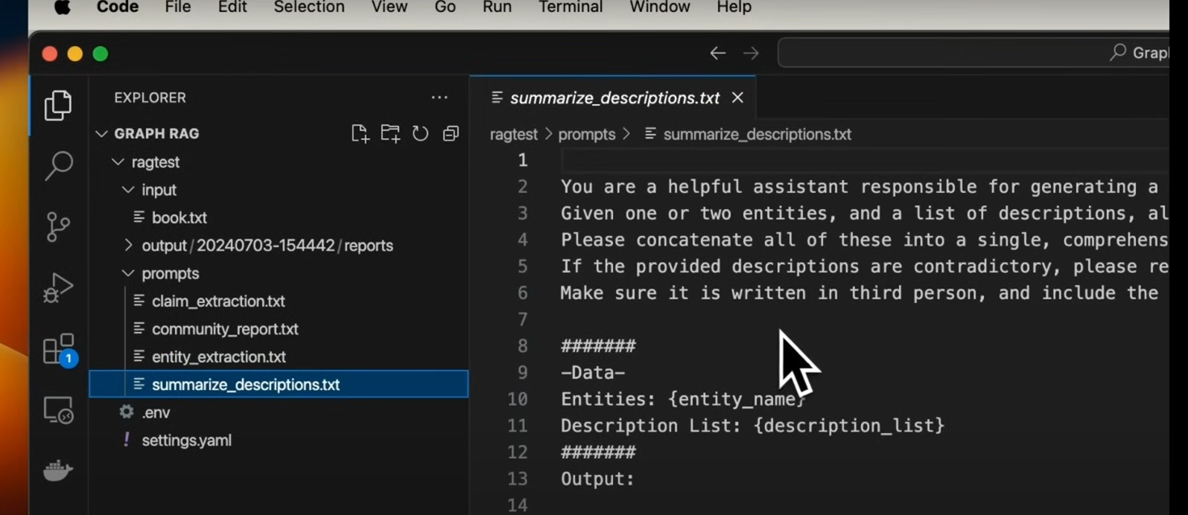
Code:

Slide 9
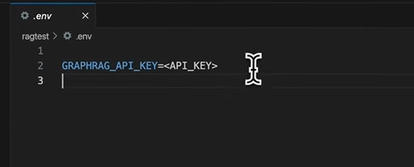
Connection with LLM:
Setting up OpenAI key for LLM:
Settings.yaml file present in the repository has all configuration setup:

Slide 10
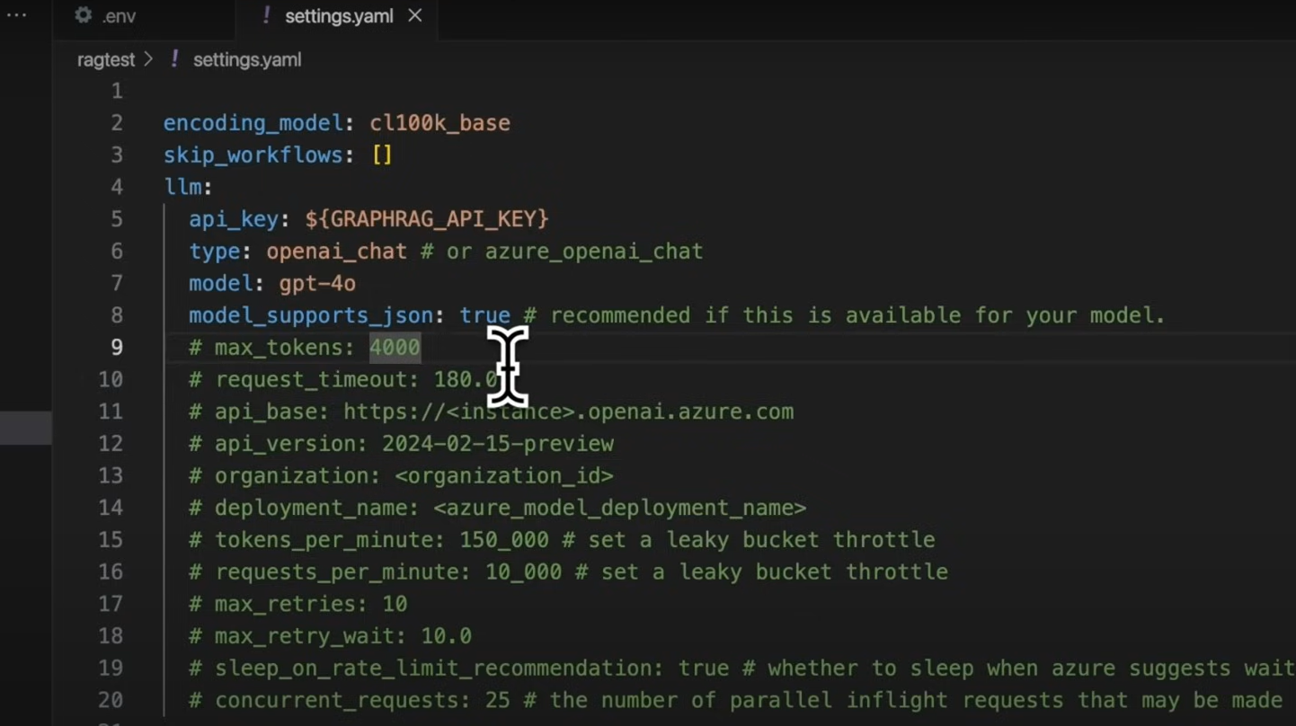
Settings.yaml file:

